Slide 1
Greyatom Test Advertisement Success Prediction presented by - Abhineet

Slide 2
PROBLEM STATEMENT
You have been hired by advertising company to assess the revenue that can be generated by a proposed ad. Based on the demographic information provided, you need to predict whether the revenue generated will cover costs to produce and air the ad(Whether there will be a net gain from an ad or not)
Data can be used to gain business insights, make decisions, behaviour and ways to optimize ads, guiding marketing initiatives, implementation of innovative additional services,boost the advertising firm’s reputation and much more.
Lets build Machine leaning model to predict Advertisement Success.

Slide 3
Business Insights:
Understanding Target variable Distribution in data
Find out relation between Target variable and various features
Gender Distribution where campaign has gained or failed respectievely.
Detect outliers in the data and handle them.
Do analysis to detect correleation among the columns and handle it.
Evaluation Metric:
Evaluation metric for this problem is F1_score(binary)

Slide 4
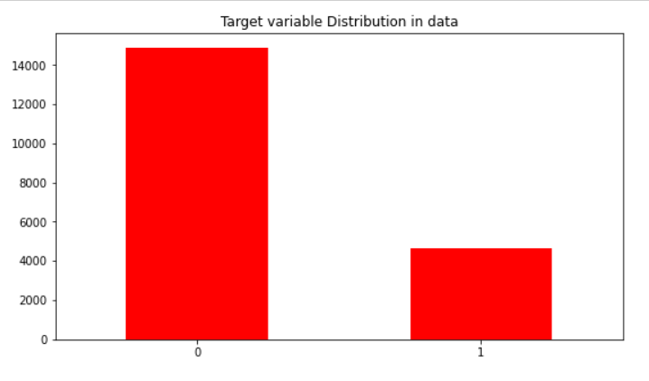
EDA
Dropped Unique_Id column.
There were no null values.
Netgain column:
- There was imbalance in the data. Value counts observed are as -0:14886, 1:4650
- Class imbalance was handled to train the model.

Slide 5
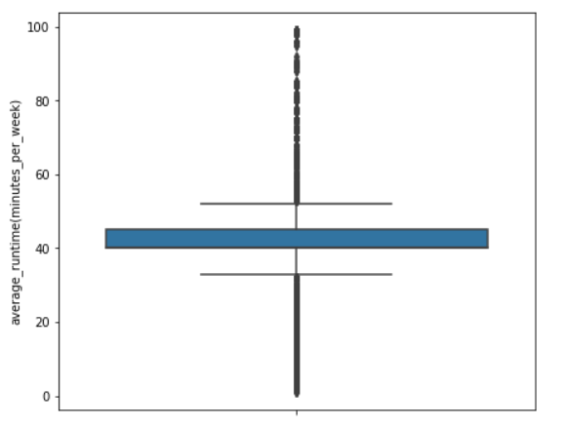
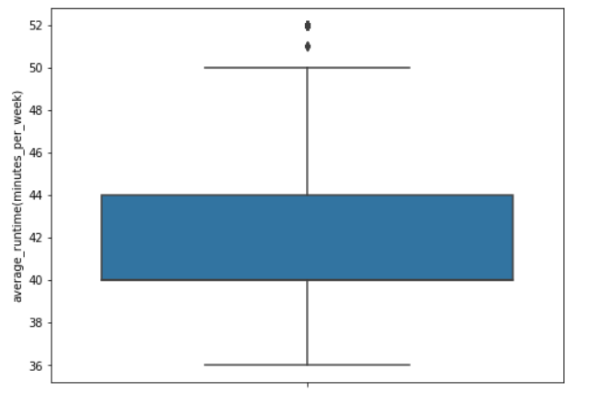
Outlier were dropped from average_runtime(minutes_per_week) and ratings columns.
Object type columns were converted into integr based columns.

Slide 6
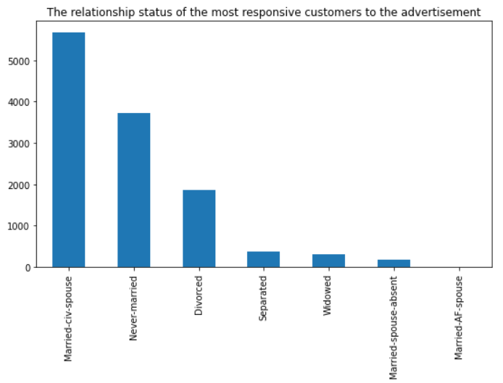
Analysis on data
- The relationship status of the most responsive customers to the advertisement was observed.
Insights:
1. Married-civ-spouse were the most responsive customers.
2. Never-married people also occupied a significant count.

Slide 7
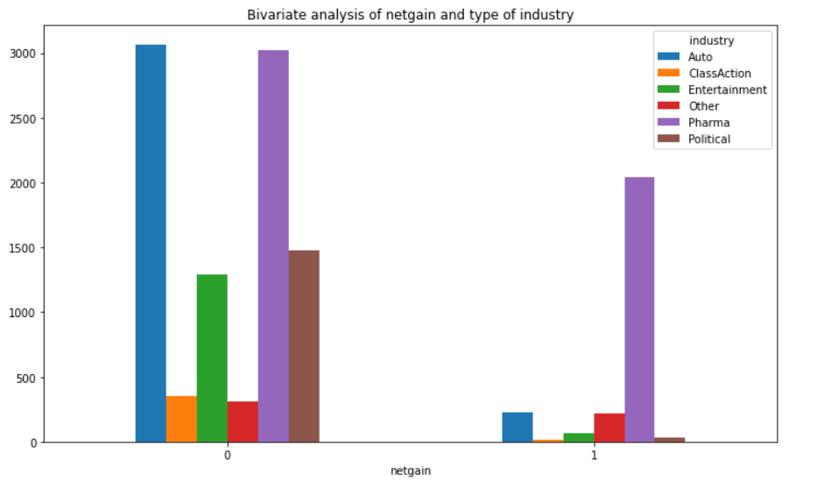
Analysis of netgain and type of industry
Insights:
Pharma was the most netgain was observed.

Slide 8
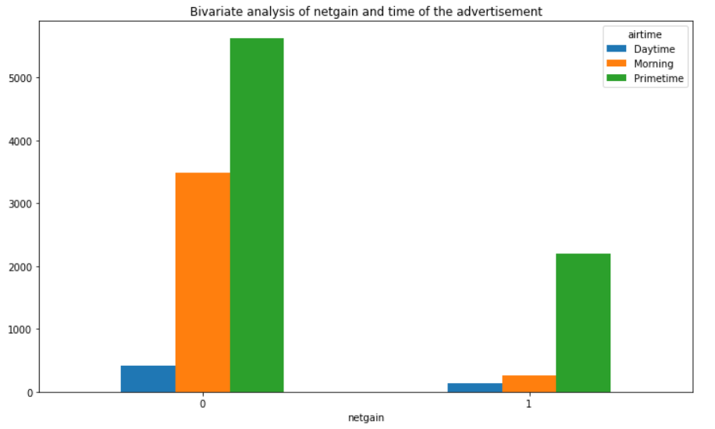
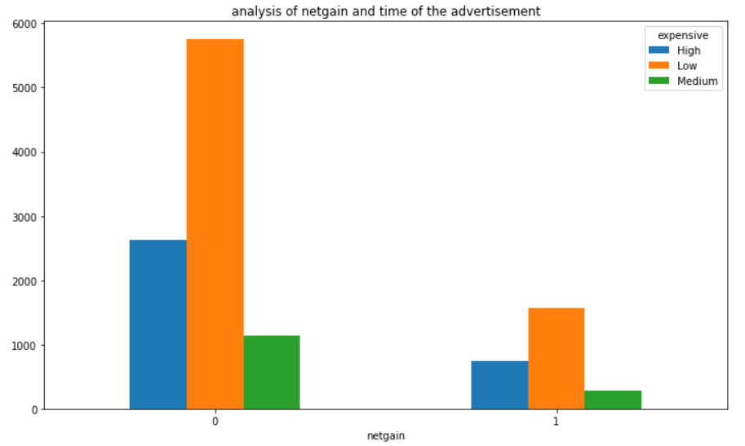
Analysis of netgain and time of the advertisement
Analysis of netgain vs cost of Ads
Insights:
Primetime ads leads to most netgain amongst any other time.
Insights:
Low cost ads lead to most netgain followed by High cost ads.

Slide 9
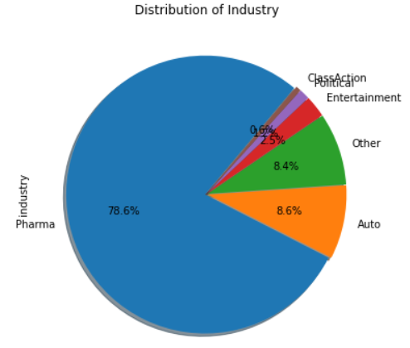
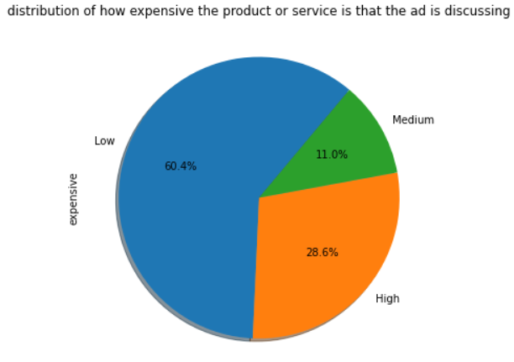
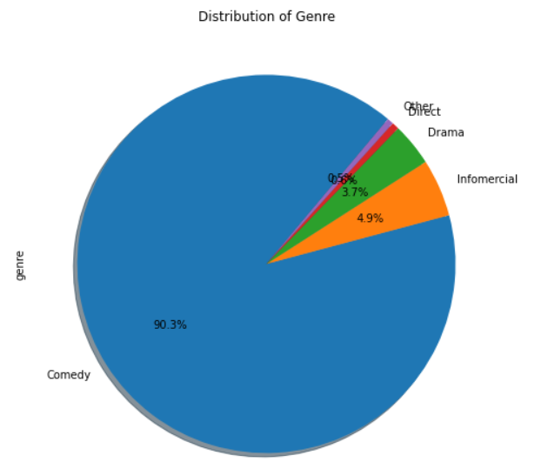
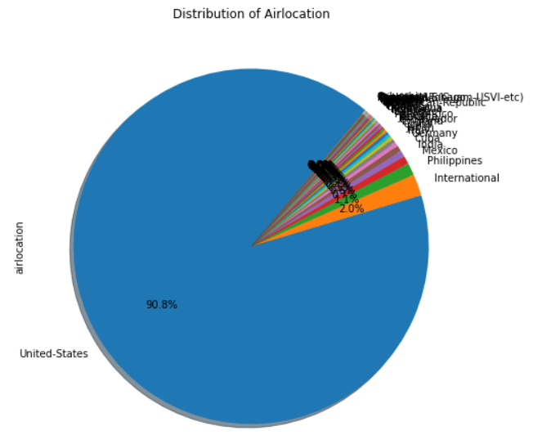
Piecharts to observe distribution among various features in data where there was netgain in the business

Slide 10
Models to train the data
Various Vanilla models were assessed without upsampling the data and tried on the models. The models were:
Logistic Regression
DecisionTreeClassifier
RandomForestClassifier
XGBClassifier

Slide 11
Results of the Models:
Model | F1_score(0) | F1_score(1) | accuracy
logisticRegression | 0.87 | 0.24 | 0.78
RandomForestClassifier | 0.81 | 0.49 | 0.77
DecisionTreeClassifier | 0.85 | 0.36 | 0.76
XGBClassifier | 0.87 | 0.36 | 0.78

Slide 12
Results of the models after upsampling the data
Model | F1_score(0) | F1_score(1) | accuracy
logisticRegression | 0.77 | 0.43 | 0.69
RandomForestClassifier | 0.78 | 0.54 | 0.70
DecisionTreeClassifier | 0.77 | 0.53 | 0.69
XGBClassifier | 0.79 | 0.57 | 0.72
XGBClassifier(tunned) | 0.79 | 0.57 | 0.72

